Slide 1
English Language Arts Overview
Created By: Penny Plavala, Literacy Specialist

Slide 2
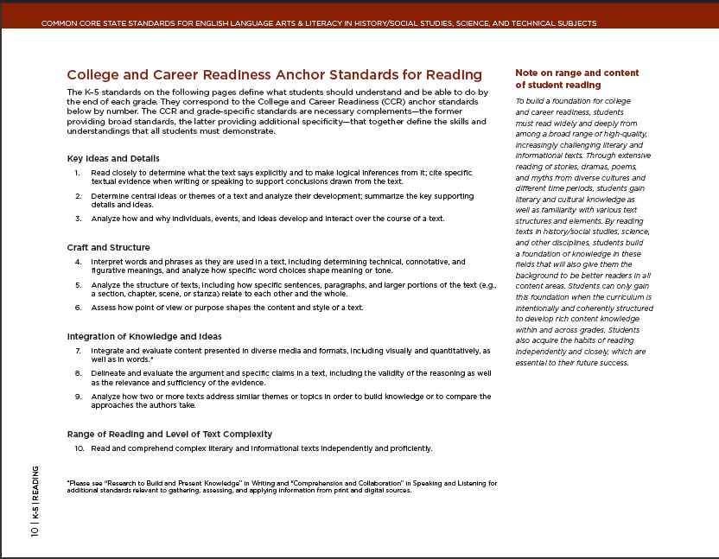
Design and Organization
College and Career Readiness (CCR) Anchor Standards
Broad expectations
consistent across grades
and content areas
Based on evidence
about college and
workforce training
expectations

Slide 3
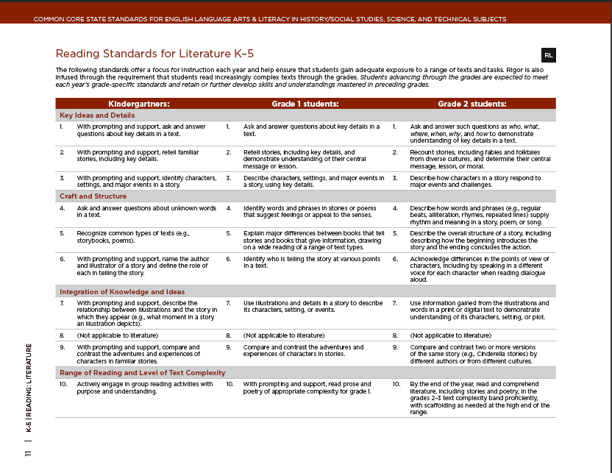
Design and Organization
K−12 Standards
Grade-specific end-of-year expectations
Developmentally appropriate, cumulative progression of skills and understandings
One-to-one correspondence with
CCR standards

Slide 4
Four Strands
Reading
Writing
Speaking & Listening
Language

Slide 5
English Language Arts
Design and Organization
Three main sections
K−5 (cross-disciplinary)
6−12 English Language Arts
6−12 Literacy in History/Social Studies, Science, and Technical Subjects
Three appendices
A: Research and evidence; glossary of key terms
B: Reading text exemplars; sample performance tasks
C: Annotated student writing samples

Slide 6
Reading
Learning to read
- Standards for Reading Foundational Skills K-5:
Phonemic Awareness, Phonics, and Fluency
Balance of literature and informational texts
Increased text complexity
6-12 standards: increased emphasis on informational text

Slide 7
Emphasis on Informational Text
Grade | Literary | Informational
4 | 50% | 50%
8 | 45% | 55%
12 | 30% | 70%
Distribution of Literary and Informational Passages by Grade in the 2009 NAEP Reading Framework

Slide 8
Standards for Reading and Writing in History/Social Studies, Science, and Technical subjects at Grades 6-12
Complement specific content demands,
not replace them
Instruction in reading, writing, speaking is a shared responsibility within a school
Skills: analyze, evaluate, use text features and structure

Slide 9
Literacy in History/Social Studies, Science,
and Technical Subjects
Explain how a simple machine works (science)
Compare/contrast world events (social studies)
Justify a solution to a problem (mathematics)
Academic vocabulary in all subjects
Read and understand more challenging texts
Notes:
Reading and writing integrated across content areas increases the opportunity and the need for more collaboration and shared responsibility within a school for developing literacy in students. An example of the way that literacy skills will be used in science, social studies and math are provided. There is also an emphasis on the teaching of academic vocabulary in all subjects.
The CCSS expect students to independently read and understand texts that are more challenging than traditionally used in the classroom.
While college reading material has maintained or increased its complexity, reading materials in K-12 have become less complex and easier to read. The reading difficulty level of workplace material is also often greater than that required of Grade 12 students.
The standards indicate that students should be able read subject area texts for the purpose of gaining information.
Standards are designed to develop students’ proficiency in literacy such that they will gradually become College and Career Ready and possess the knowledge and skills necessary to successfully enter post-secondary education or the world of work.

Slide 10
Writing
Text types, responding to reading, and research
Arguments / opinions
Informative / explanatory texts
Narratives
Research projects
Higher standards for writing at earlier grade levels

Slide 11
Language
Conventions (effective use) and vocabulary
Standards include the essential rules of standard and written English, but also look at language as a matter of craft and making choices.
Determine word meanings, increase vocabulary

Slide 12
Speaking and Listening
Flexible, effective communication and collaboration
Standards require students to develop a range of broadly useful oral communication and interpersonal skills, for small group discussions and formal presentations

Slide 13
An Integrated Model of Literacy
From the CCSS Introduction:
“While the standards delineate specific expectations in
each of these four categories, each standard need not
be a separate focus for instruction and assessment.
For example, Writing standard 9 requires that
students be able to write about what they read.
Often, several standards can be assessed
through a single rich task.”

Slide 14
Students who are college and career ready in English Language Arts:
Demonstrate independence in reading and writing
Comprehend as well as critique
Use technology and digital media strategically and capably

Slide 15
Writing Modes
Oregon Standards CCSS
Expository
Persuasive
(Personal) Narrative
(Fictional) Narrative /
Imaginative
Informative / Explanatory
Opinions / Arguments
Narrative (real)
Narrative (imagined)

Slide 16
Review of ELA Anchor Standards
Writing = 10 standards
Speaking and Listening = 6 standards

Slide 17
Review of ELA Anchor Standards
Language = 6 standards
Note: CCR Anchor Standards for Writing, Speaking &
Listening, and Language are in the back of your packet

Slide 18
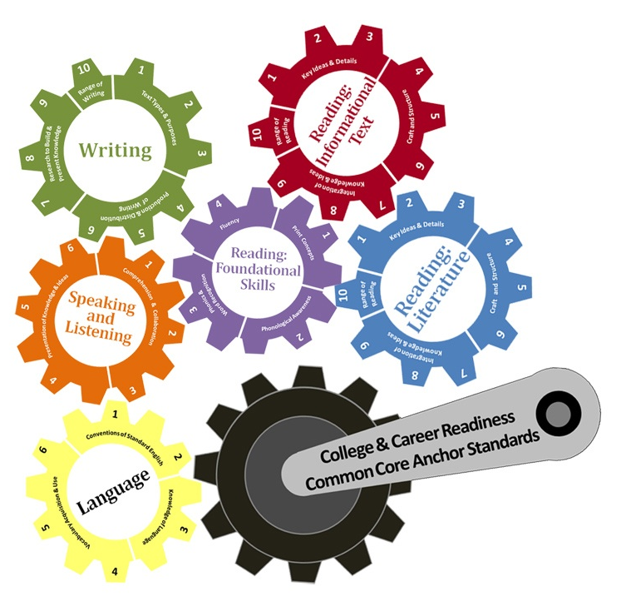

Slide 19
English Language Arts – Instructional Shift
Traditional Classroom
Focus on literature (fiction)
Literary skills (identifying terms
and devices)
ELA standards taught in isolation
Common Core Classroom
Informational texts prepare for college and career
Cross-content literacy
ELA standards taught in collaboration
Notes:
The CCSS represents a significant shift in instructional focus in classrooms. The traditional English classroom is typically focused on reading literature such as poetry and Shakespeare.
To better prepare students for college and a career, the core standards indicate the importance of also reading, understanding, and responding to historical, scientific, and technical text.
This integration of literacy across the content areas encourages all teachers to collaborate to better prepare students for postsecondary success.
The ELA CCSS represent an opportunity for integration and collaboration in a school.

Slide 20
Check-in
Share with your partner what new information you learned today about the English Language Arts Standards.

