Slide 1

Defending Childhood Initiative
This project was supported by Grant Number 2012-CV-BX-K055 awarded by the Office of Juvenile Justice and Delinquency Prevention, Office of Justice Programs, U.S. Department of Justice. Points of view or opinions in this document are those of the author and do not necessarily represent the official position of the U.S. Department of Justice.

Slide 2
Agenda
Trauma and resiliency frameworks
Rewiring for Growth: trauma and its impact on the brain
Trauma Sensitive Behavior response, action planning!
Intersectional Identities and The Cost of Caring

Slide 3
Trauma and resiliency frameworks

Slide 4
Tracking awareness during today’s session
BODY
THOUGHT
EMOTION
SPIRIT

Slide 5
Trauma sensitive meetings
Breaks (rhythm and movement)
Acronyms
Physical space (room)
Clearly stated expectations and goals

Slide 6
In this session, we will:
Define trauma and resiliency
Apply a race and equity lens to broaden conventional definitions of trauma and resiliency
Erin Fairchild, MSW and Kate Gigler, MSW

Slide 7
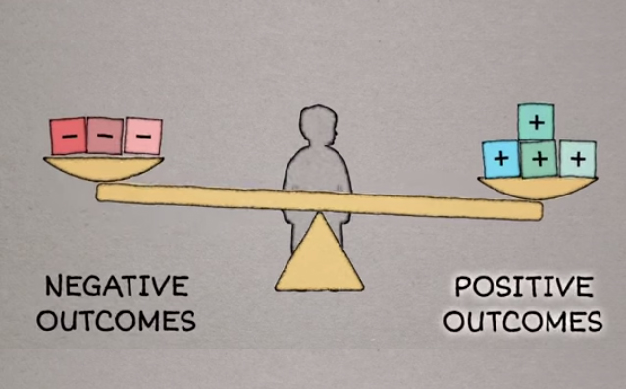
Starting with resiliency
Related term: protective factors
Erin Fairchild, MSW & Kate Gigler, MSW
Notes:
Harvard center video:
https://www.youtube.com/watch?v=1r8hj72bfGo
7

Slide 8
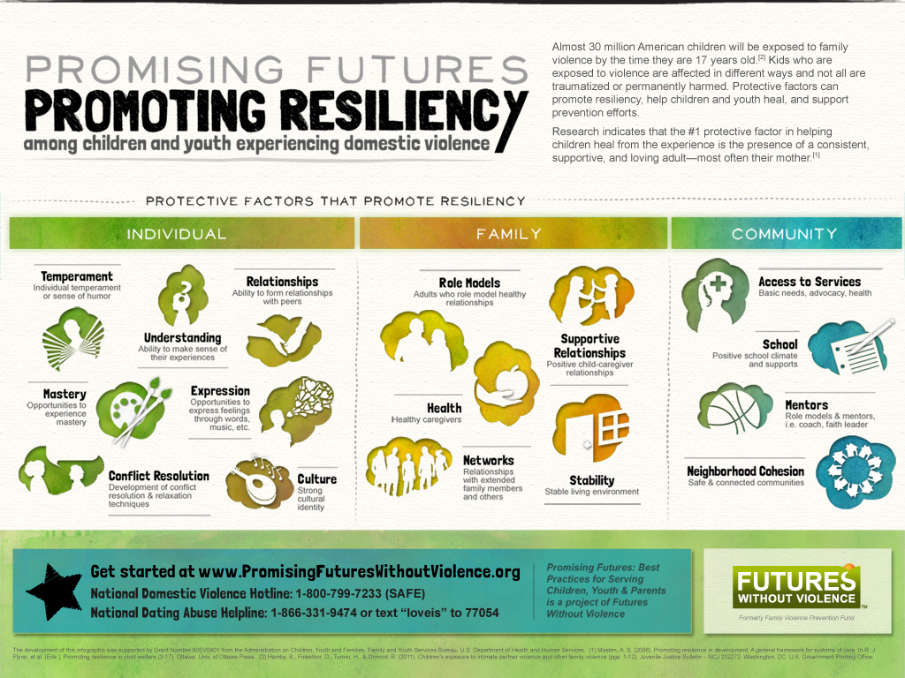
Erin Fairchild, MSW & Kate Gigler, MSW
Notes:
8

Slide 9
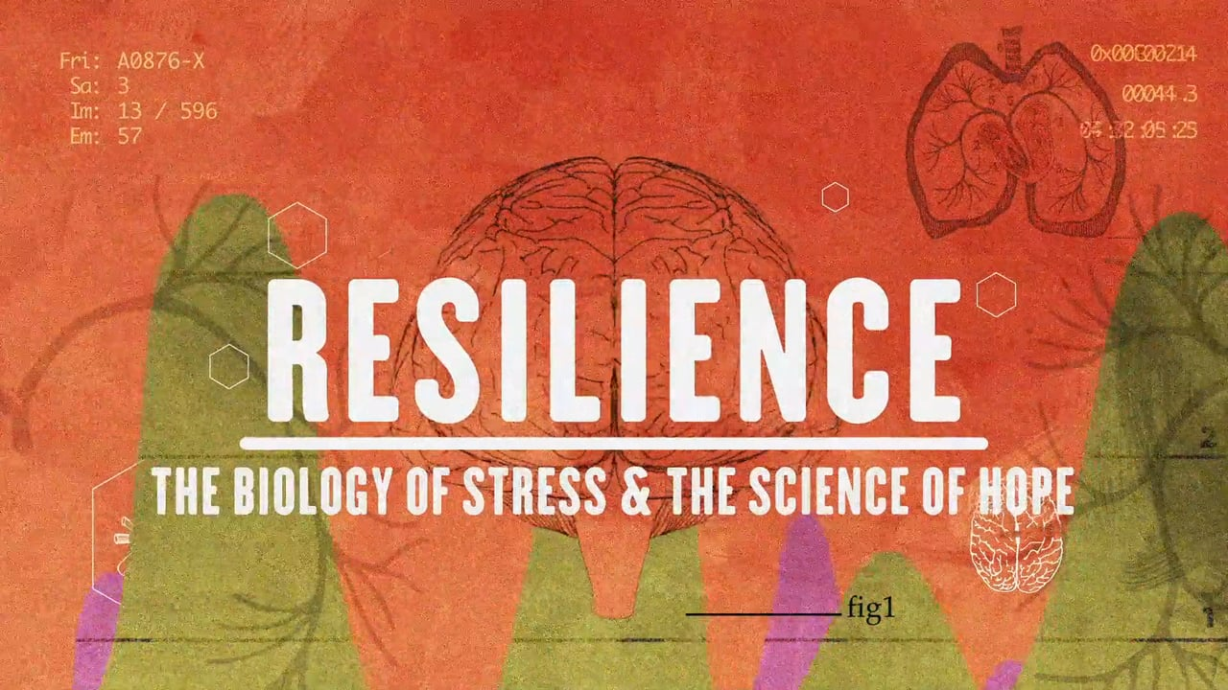
An introduction to the concepts:
Erin Fairchild, MSW & Kate Gigler, MSW
Notes:
https://vimeo.com/137282528
9

Slide 10

Adversity in Oregon…
Adverse Childhood Experiences (ACE) Category | ACEs Study | OHT Survey 2014
Parental Separation or Divorce | 23.3% | 44.3%
Household Substance Abuse (OHT-problem drinker) | 26.9% | 39.1%
Household Mental Illness (OHT- depression) | 19.4% | 35.7%
Emotional Neglect | 14.8% | See below
Physical Neglect | 9.9% | See below
Not Enough to Eat | See above | 23.7%
Had to Wear Dirty Clothes | See above | 14.9%
No One to Protect Them | See above | 14.9%
State of Oregon Chief Education Office, 2017, used with permission

Slide 11

Types of Trauma
Acute
Ambient
Chronic
Toxic Stress/Complex Trauma
Notes:
Institutional trauma? How to include?
Another slide or quadrant on institutional racism. Pie chart, with circle on the outside for institutionalized marginalization, with racism being the most prominent form.

Slide 12



Context of Trauma & Violence
TOXIC
Acute Trauma
RACISM, POVERTY, ETC
STRESS
COMPLEX TRAUMA
HISTORICAL TRAUMA*
SYSTEMIC VIOLENCE
*Historical trauma with a current and traumatic socio-political context
INSTITUTIONALIZED TRAUMA
Erin Fairchild, MSW

Slide 13

Self Regulation
Rhythm
Erin Fairchild, MSW and Kate Gigler, MSW

Slide 14


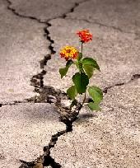
Context of Healing & Resiliency
Recovery &
Cultural Level Resiliency & Empowerment
HEALING
C
Community Level Resiliency & Empowerment
Individual level resources
Social Justice
Personal Resiliency & Empowerment
Family Level Resiliency & Empowerment
Equity
Erin Fairchild, MSW

Slide 15

Unique’s Story
Notes:
https://www.youtube.com/watch?v=NRIECTLFhkM

Slide 16
A trauma-sensitive school…
Realizes both the widespread impact of trauma and the role the school can play in promoting resiliency; recognizes the signs and impacts of trauma in students, families and staff; and responds by fully integrating knowledge about trauma into policies, procedures, and practices, and seeks to actively resist re-traumatization of students and staff.
* Adapted from SAMHSA’s Concept of Trauma and Guidance for a Trauma Informed Approach (2014) by the DCI trauma informed schools advisory group.
Notes:
Describe work of schools advisory group

Slide 17
Rewiring for Growth: the impact of trauma on the developing brain

Slide 18
Tracking awareness during today’s session
BODY
THOUGHT
EMOTION
SPIRIT

Slide 19
In this session, we will:
Describe the impacts of trauma on brain development
Use the ‘brain in the hand’ model to identify brain architecture and basic function
Describe one example of how to regulate the emotional and physiological states of students
Describe how neural connections can be built (or ‘rewired’) through repeated calming experiences within relationships with adults perceived as safe.
Erin Fairchild, MSW and Kate Gigler, MSW

Slide 20
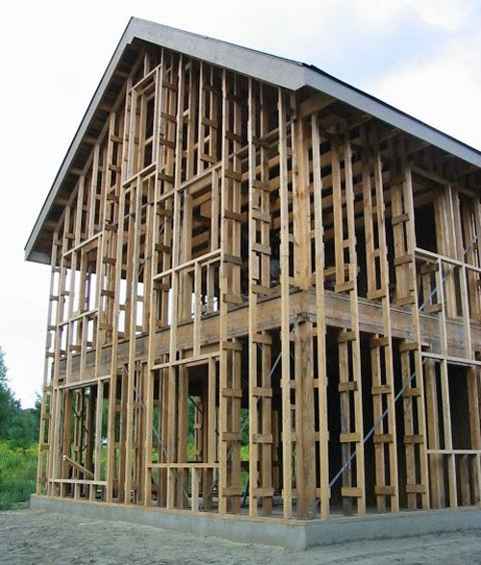
Brain development is like constructing a building. You can always remodel and add-on, but the foundation must be strong.
Erin Fairchild, MSW and Kate Gigler, MSW
20

Slide 21
As the brain develops upward and outward, emotional regulation skills become more complex, IF we have learned basic emotion regulation.
Cortex
Limbic
Basic emotional regulation happens here, & is developed by our experience.
Midbrain
Brainstem
Erin Fairchild, MSW and Kate Gigler, MSW
21

Slide 22
Abstract thought
Concrete thought
Affiliation
Attachment
Sexual behavior
Emotional reactivity
Motor regulation
Arousal
Appetite
Sleep
Blood pressure
Heart rate
Body temperature
-Dr. Bruce Perry
Cortex
Limbic
Midbrain
Brainstem
Erin Fairchild, MSW and Kate Gigler, MSW
22

Slide 23
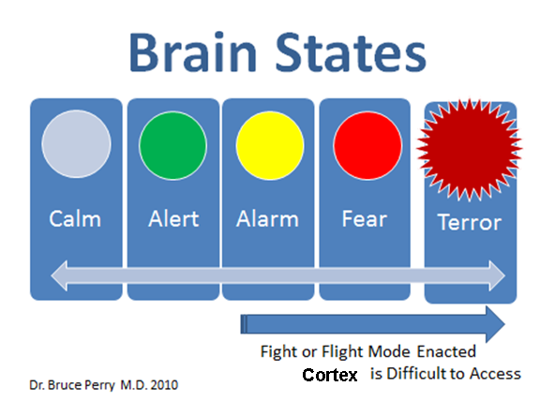
Image by Dr. Bruce Perry, M.D. Used with permission
Erin Fairchild, MSW and Kate Gigler, MSW

Slide 24
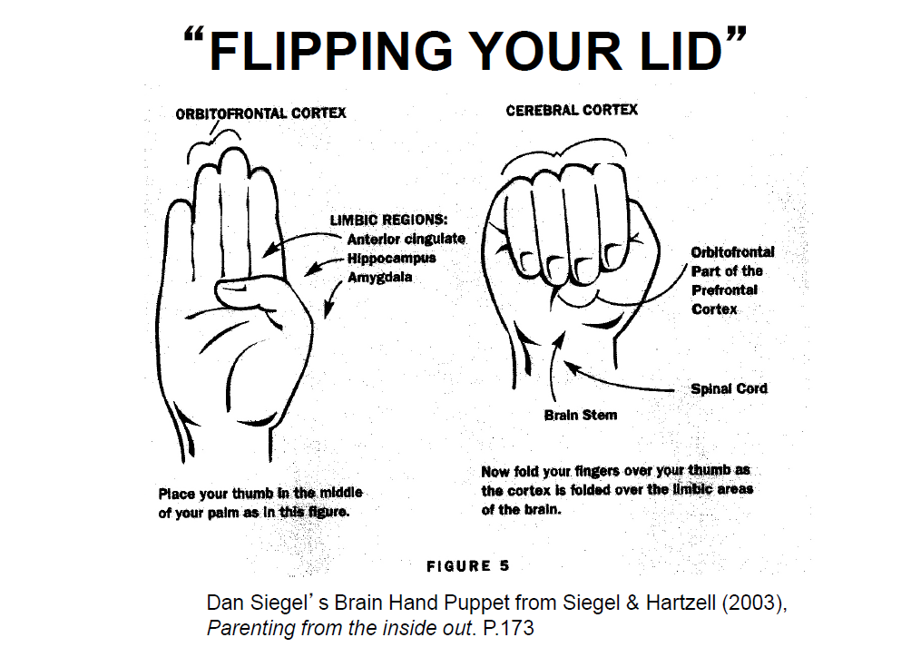
Fight: Physiological Arousal
Flight: Withdrawal
/ escape
Freeze: Stilling &
constriction
Erin Fairchild, MSW and Kate Gigler, MSW

Slide 25

25
Erin Fairchild, MSW & Kate Gigler, MSW
Notes:
https://www.youtube.com/watch?v=ELpfYCZa87g

Slide 26
Tracking awareness during this morning’s sessions
BODY
THOUGHT
EMOTION
SPIRIT

Slide 27
Race, Gender and Intersecting
Systems of Oppression

Slide 28
Tracking awareness during today’s session
BODY
THOUGHT
EMOTION
SPIRIT

Slide 29
In this session, we will:
Define intersectionality and examine how the intersections of racism, sexism, and other oppressions create vulnerabilities and invisibility for students in the community, school systems, and the class environment.
Discuss how the relationship between social identity and power can exacerbate the experience of violence for students.
Think about school community’s role in promoting inclusivity, visibility and equity.
Erin Fairchild, MSW and Kate Gigler, MSW

Slide 30

Above and below the line identities
Fight: Physiological Arousal
Flight: Withdrawal
/ escape
Freeze: Stilling &
constriction
Erin Fairchild, MSW and Kate Gigler, MSW

Slide 31
Intersectionality
Intersectionality is a concept often used in critical theories to describe the ways in which oppressive institutions (racism, sexism, homophobia, transphobia, ableism, xenophobia, classism, etc.) are interconnected and cannot be examined separately from one another.
Erin Fairchild, MSW and Kate Gigler, MSW

Slide 32
Cost of Caring: risk and protective factors for vicarious trauma

Slide 33
In this session, we will:
Define vicarious trauma and professional resiliency
Define a professional ‘hot spot’ and identify one personal example.
Identify sources of internal and external supports that reduce stress during professional transitions, e.g. coming back from summer break.
Erin Fairchild, MSW and Kate Gigler, MSW

Slide 34
Professional resiliency
vicarious trauma and burnout
**Hot spots**

Slide 35
Zones of professional resilience
Erin Fairchild, MSW and Kate Gigler, MSW

Slide 36
Pair/share prompts:
What types of activities are in your comfort zone, challenge zone, stress zone and your trauma zone?
Erin Fairchild, MSW and Kate Gigler, MSW

Slide 37
Risk factors for vicarious trauma:
Past history of trauma
Constantly filling roles that are outside one’s job description
Minimal experience recognizing and responding to trauma
Isolation
Overwork
High % of traumatized children
Too many perceived negative outcomes
High student to staff ratios
Adapted from the Sanctuary Institute: The Sanctuary Model

Slide 38
Pair/share prompts:
Which of these risk factors are more likely to pull you into the red (stress) and purple (trauma) zones?
Are there any other conditions that deplete you professionally that are not listed here?
Erin Fairchild, MSW and Kate Gigler, MSW

Slide 39
Protective factors which support professional resiliency
Belief of competence in practice strategies
Strong ethical principles of practice
Social Support
Awareness of vicarious trauma
Post traumatic growth
On going training
Reflective supervision and consultation
Knowledge of theory
Celebration of success
Opportunities for physical and emotional regulation
Adapted from the Sanctuary Institute: The Sanctuary Model

Slide 40
Pair/share prompts:
Define professional resiliency for yourself.
Which of these conditions are more likely to pull you into the green (comfort) and yellow (challenge) zones?
Are there any other conditions that sustain you professionally that are not listed here?
Erin Fairchild, MSW and Kate Gigler, MSW

Slide 41

It’s not just about taking a bubble bath.

Slide 42
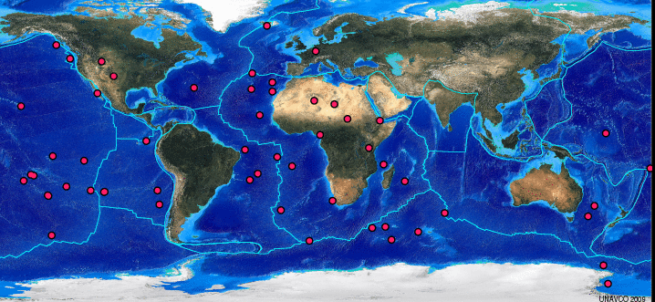
Hot Spot: an interaction, physical space or other set of circumstances that, at a minimum, activates our physiological stress response and at most, can be re traumatizing.

Slide 43
Hot Spot examples from us:
Physical space
The poorly placed phone.
The paper towel dispenser
Staff interactions
“I don’t know why that family accesses the food bank; they drive that Escalade.”
Student interactions
Middle school lunch dismissal
Chronic relational bullying among peers

Slide 44
Pair/share prompts:
What are your own personal signs that your stress response system is activated?
What specific situations – or ‘hot spots’ - are more likely to bring up your own stress response system at school?
Erin Fairchild, MSW and Kate Gigler, MSW

Slide 45

What are some things you do in the moment to regulate or ‘calm’ your stress response?
Erin Fairchild, MSW & Kate Gigler, MSW
Notes:
45

Slide 46
Tracking awareness during today’s session
BODY
THOUGHT
EMOTION
SPIRIT

Slide 47
Trauma Sensitive
Behavior Response

Slide 48
Tracking awareness during today’s session
BODY
THOUGHT
EMOTION
SPIRIT

Slide 49
In this session we will:
Describe strategies that are used in this school or setting to promote physical and emotional safety.
Define parallel process.
Define and identify existing strategies in the domains of regulate, relate reason.
Erin Fairchild, MSW and Kate Gigler, MSW

Slide 50
Bringing it back to neuroscience:
Fight: Physiological Arousal
Flight: Withdrawal
/ escape
Freeze: Stilling &
constriction
Reason
Relate
Regulate
Erin Fairchild, MSW and Kate Gigler, MSW

Slide 51
Image by Dr. Bruce Perry, M.D. Used with permission
Erin Fairchild, MSW and Kate Gigler, MSW

Slide 52
How does it overlay?
Trauma specific interventions
Identification and engagement with trauma sensitive supports.
Trauma sensitive practices for classrooms. ‘Universal precaution’

Slide 53
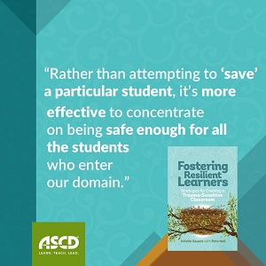

Slide 54
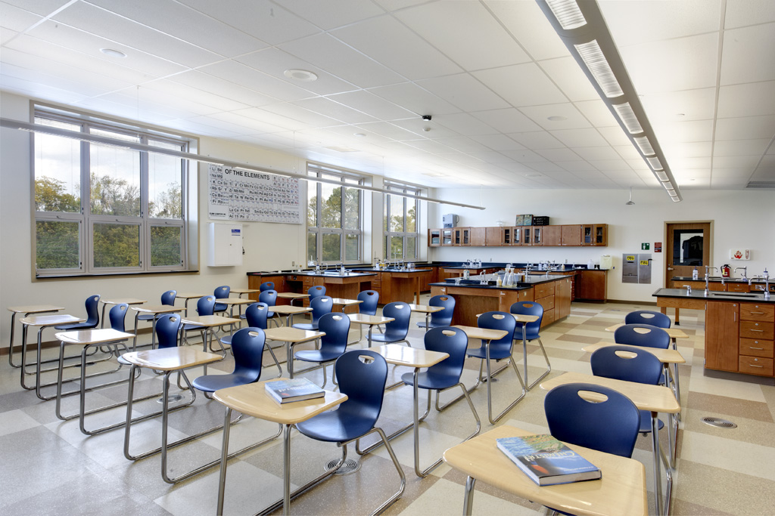
Pair/Share prompt:
How do you make your settings ‘safe’ for students and families?

Slide 55
Parallel Process: every strategy used with by a staff with a student will also ideally be in practice among staff and between staff and leadership.
Relationship that leadership has with staff
Relationship that staff has with each other
Relationship that staff have with students

Slide 56
What is the short hand?
Regulate
Relate
Reason
Adapted from Collaborative Problem Solving (Bruce Perry), but also reflected in consistent approaches such as Attachment Regulation and Competency (ARC) and mindfulness

Slide 57
Am I online?
(REGULATE)
Is this student online?
(REGULATE)
What does this student need most right now? What is this student’s emotional experience?
(RELATE)
How can I incorporate this into my plan for myself and this student next time?
(REASON)

Slide 58
What is regulation?
Unroll & roll up ball of yarn
Listen to music
Make observations about surroundings
Adult models deep breaths
Cool off time (not time out as punishment)
Scribble
Take a walk, change environment
Drink water or eat a snack
Tactile experiences

Slide 59
Regulate
Routine and ritual
The regulation activity has never been used as a form of punishment
Parallel practice
Safe adults practice and improve regulation skill alongside students
Non punitive
Practiced regularly, predictably

Slide 60
Relate:
Trauma informed inquiry
Do I have the ability, in this heated moment, to separate out my own needs and wants, as an educator, from the needs and wants of the student in front of me?
Do I have the ability to have reflective curiosity about the underlying need being expressed or ‘flagged’ by this student’s behavior?

Slide 61
Relate: sample script
“I care about you. I am going to help you be calm so we can figure out what comes next.”
“You have really big feelings right now, and they seem to be taking over. Let’s take a breath to help you be in charge.”
“When we get scared or overwhelmed, our brains can turn off. I can help you learn to turn your brain back on.”

Slide 62
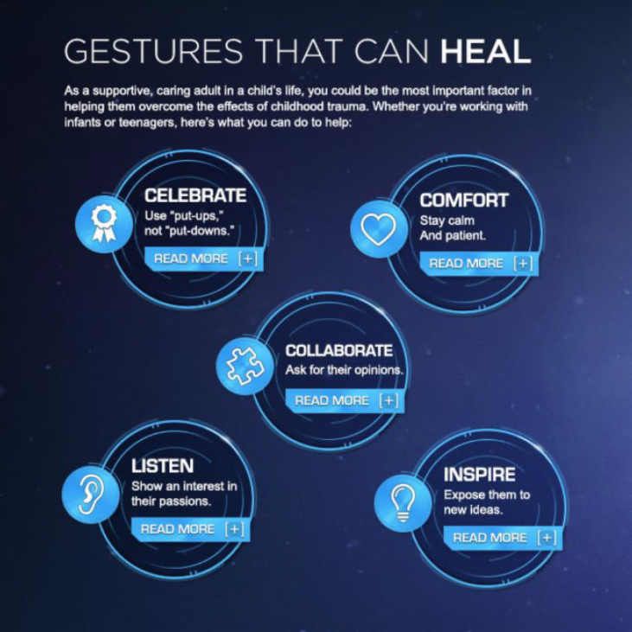
Reason: Everyday gestures

Slide 63
Am I online?
(REGULATE)
Is this student online?
(REGULATE)
What does this student need most right now? What is this student’s emotional experience?
(RELATE)
How can I incorporate this into my plan for myself and this student next time?
(REASON)

Slide 64
Small group prompt:
Regulate: What are regulation strategies you have seen used in this building?
Relate: When you are able to have reflective curiosity about a student, what types of things do you wonder? What are your back pocket ‘scripts’ to help you relate?
Reason: How do you collaborate with a student to plan for the next time you will need to regulate?
Erin Fairchild, MSW & Kate Gigler, MSW
Notes:
64

Slide 65
Tracking awareness during today’s session
BODY
THOUGHT
EMOTION
SPIRIT

